Slide 1
Thesis update
Susan van de Sande

Slide 2
Current data sources
Load consumption
2021-2023
Hourly
Weather
1901-2023
Daily/hourly
NAO index
1950-2023
Monthly
Energy price
2018-2023 (May)
Monthly
Renewable energy usage
2015-2022
Yearly
Options for “missing” energy price and renewable energy usage in 2023:
Use data 2021-2022: this way we don’t use 2023
Disgard renewable energy and energy price: this way we can use 2023 but we miss these features
Impute the missing data: e.g. use the trend of the exisiting data/use the average/…

Slide 3
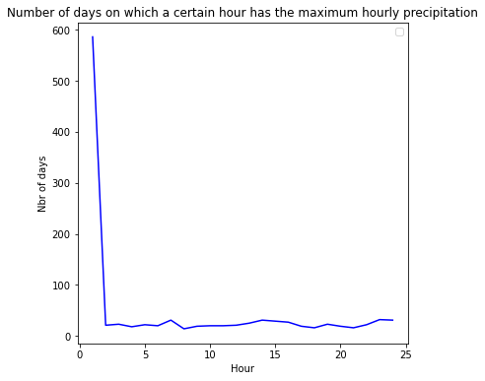
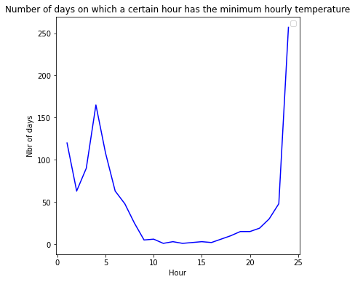
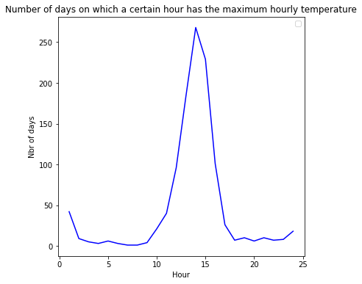
Weather data: temperature
Data is on daily level and shows on which hour of day the minimum/maximum precipitation, windspeed and temperature occur.
New feature: we only have the hourly value of one hour of the day at which the min/max occurs. We fill all the hours with this value but create an additional column to flag the hour at which this occurred.

Slide 4
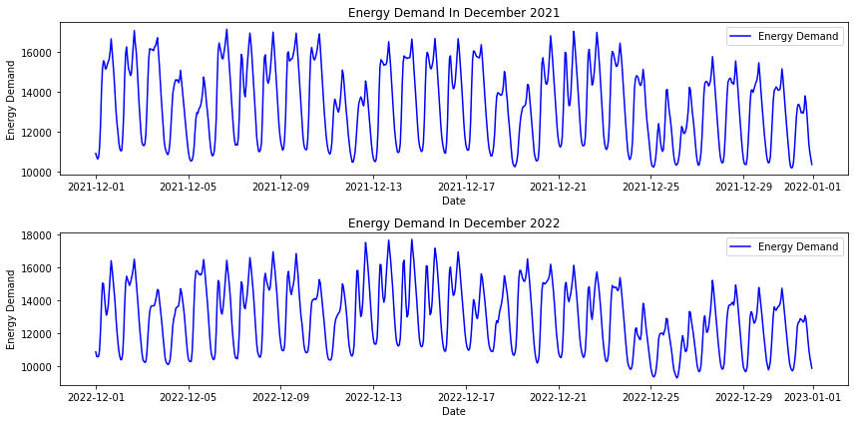
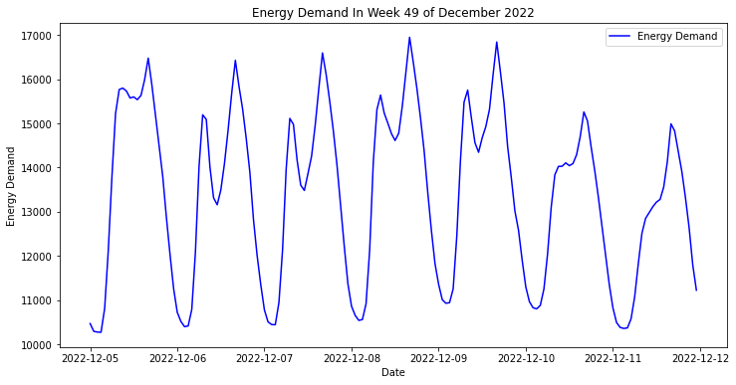
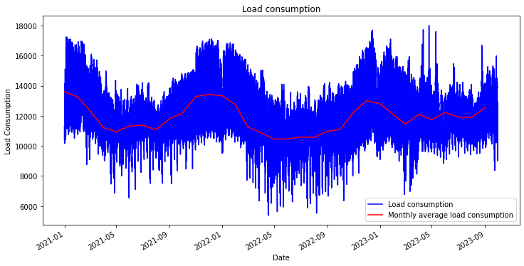
Load consumption data
Load data has daily, weekly, monthly and yearly seasonality

Slide 5
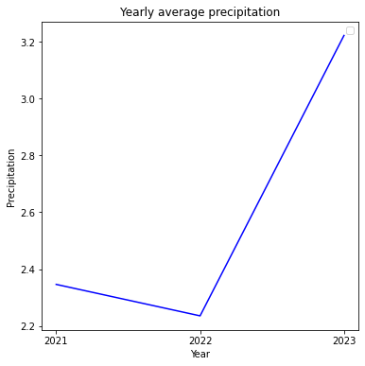
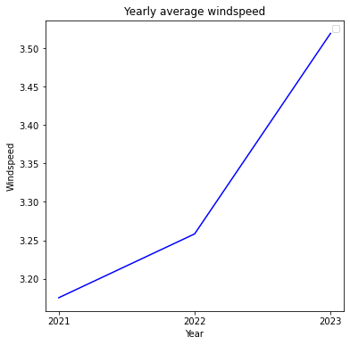
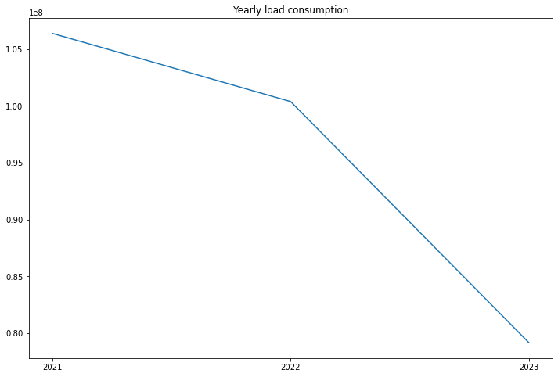
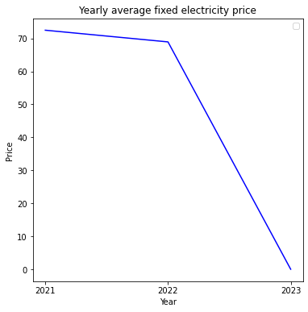
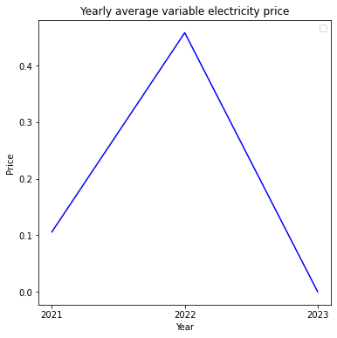
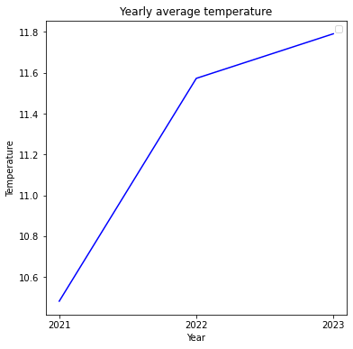
Load consumption data
Trend seems to be downward, decrease from 2021-2022 is smaller than decrease from 2022-2023.
Upward trend in precipitation and windspeed, not sure yet how these explain less energy consumption
Fixed electricity price is decreasing. Variable price was very high in 2022.
Downward trend explainable because of higher temperature?

Slide 6
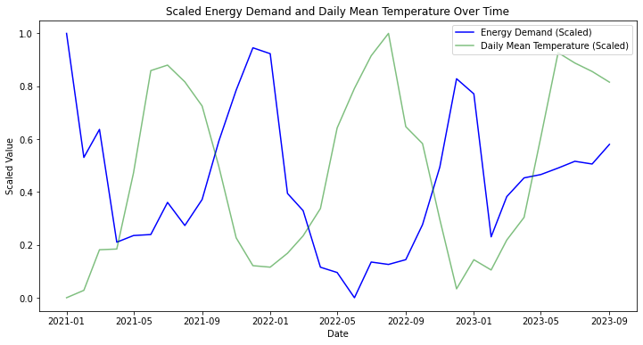
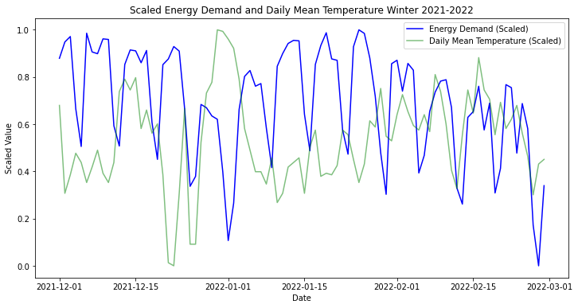
Load consumption data
Every time energy demand goes up, temperature goes down and vice versa. This is the case for the entire year and also wintertime: makes sense because more heating required for example.

Slide 7
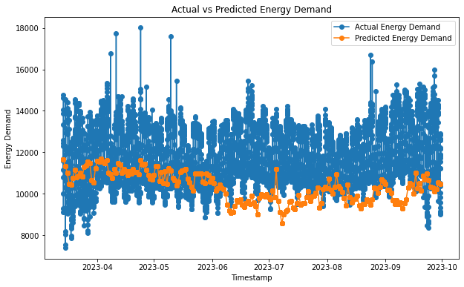
Multiple linear regression
Using features DailyPrecipitation, DailyMeanTemperature, DailyMeanWindspeed, NAO, Month, Year. RMSE of 2299; correlation: -0.05773285303594856 and p-value: 6.113215074153206e-05. It does not make sense to only use daily features when we want to predict on hour level. Forecast seems to be underforcasting.

Slide 8
Prophet
Tried with different settings: with/without regressors and with/without seasonality
Regressors | Seasonality | RMSE | Pearson corr.
None | None | 1390.71 | Correlation: 0.7285420461682013 and p-value: 0.0
DailyPrecipitation, DailyMeanTemperature, DailyMeanWindspeed, NAO, Month, Year | Fourier weekly = 7 Fourier annual = 7 (randomly selected) | 1355.73 | Correlation: 0.6611963439202649 and p-value: 0.0
DailyPrecipitation, DailyMeanTemperature, DailyMeanWindspeed, NAO, Month, Year | Daily_seasonlity = True Weekly_seasonality = True Yearly_seasonality = True (Prophet selects the fourier terms) | 1197.42 | Correlation: 0.7344082153606007 and p-value: 0.0
Note: we got a RMSE of 2299 using MLR so already better. Also higher correlation, MLR got negative correlation of -0.05 whereas we now have a correlation of >0.66. This is higher than the results obtained by Li.

Slide 9
Pearson correlation test
Predictor | Correlation | P value | Significant?
DailyPrecipitation | 0.09 | 3.721329976276096e-40 | Yes
MaxHourlyPrecipitation | 0.03 | 2.746445773881304e-07 | Yes
DailyMeanTemperature | -0.31 | 0.0 | Yes
HourlyMinTemperature | -0.21 | 1.0414838824655592e-231 | Yes
HourlyMaxTemperature | 0.35 | 0.0 | Yes
DailyMeanWindspeed | 0.10 | 2.1721498367041573e-49 | Yes
MaxHourlyMeanWindspeed | 0.06 | 1.3119975791126109e-20 | Yes
MinHourlyMeanWindspeed | 0.13 | 2.4759484729260415e-89 | Yes
NAO | 0.05 | 1.7416328951610607e-16 | Yes
MaxPrecipitationHourFlag | 0.06 | 3.425002965759119e-19 | Yes
MinTemperatureHourFlag | 0.09 | 1.390223556872904e-40 | Yes
MaxTemperatureHourFlag | 0.03 | 7.012572189234775e-08 | Yes
MaxMeanWindspeedHourFlag | -0.05 | 5.979568620371074e-13 | Yes
MinMeanWindspeedHourFlag | -0.06 | 2.47450736488081e-18 | Yes
Predictor | Correlation | P value | Significant?
Biomass | 0.18 | 1.7090212556249778e-122 | Yes
Windenergy | -0.18 | 1.7090212556249778e-122 | Yes
Solar energy | -0.18 | 1.7090212556249778e-122 | Yes
Heat pump | -0.18 | 1.7090212556249778e-122 | Yes
Fixed electricity price incl. VAT | 0.10 | 5.388977712966106e-41 | Yes
Variable electricity price incl. VAT
Note: all correlations are significant so not sure if I did something wrong. Need to check this still.

Slide 10
Next steps
Figure out why p-values of pearson correlation test are 0.0
Experiment with different settings in Prophet
Figure out what to do with ”missing” energy price and renewable energy consumption data

